Slide 1

Investment Primary Plan
By Carlos Urrutia Martínez

Slide 2

Invest!
Do you know each day your money value drops?
Investments are a must and should be taught in schools

Slide 3
Here’s what you need to know:
Save your Money
01
02
03
04
05
06
What is inflation and how it affects your money
Compound Interest
Markets: SP500, Bonds & Bitcoin
Rentability vs Volatility
Investment profile: Which one is yours?
Financial Plan

Slide 4

What is inflation and how affects your money
01

Slide 5
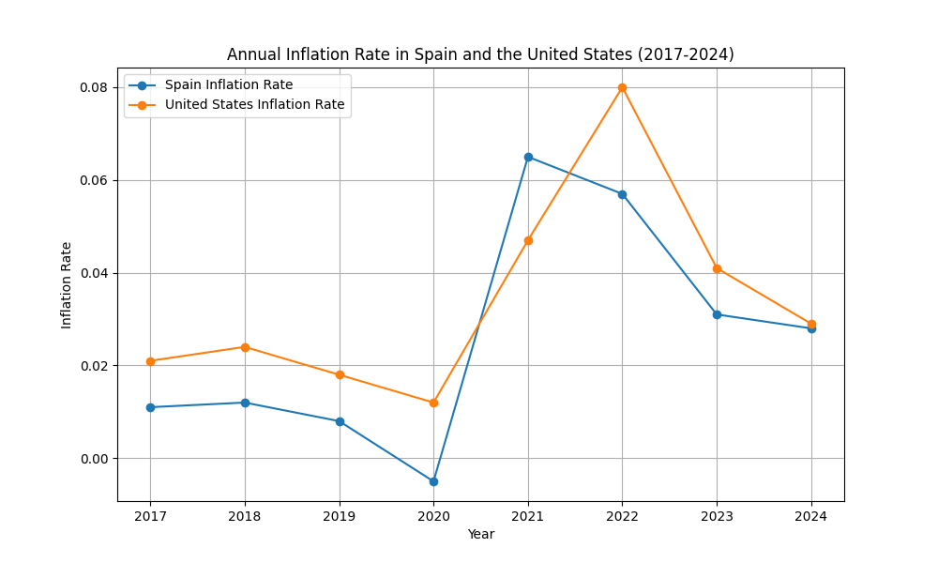
Inflation
Inflation is the gradual increase in prices over time, reducing the purchasing power of money. As goods and services become more expensive, the same amount of money buys less. This is why saving without investing leads to a loss of value—money needs to grow to keep up with inflation.
The inflation it’s a reality and it growths more in long terms

Slide 6

Problem
Solution
If you have as an example 30.000€/$ and you save them in 8 years but all of the expenses are more expensive, your money doesn’t cost the same
If you invest your money you fight the inflation and you avoid the value lost

Slide 7

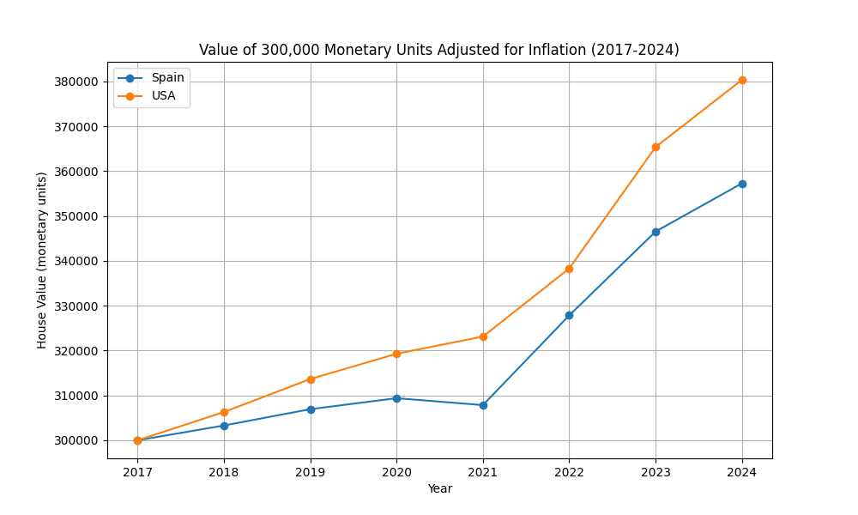
Example: I want to buy a house
Here we have an example of the value of a hypothetical house in USA and in Spain and how inflation affects the price on time What if you kept your 30.000€/$ instead of investing them and you want to buy a house with a 90% mortgage in 2024?

Slide 8

02
Compound Interest

Slide 9

Put your money in good hands and wait for it
Compound Interest is the interest earned on both the original amount of money (the principal) and the interest that has already been added. Unlike simple interest, which only calculates interest on the principal, compound interest grows exponentially over time because you earn interest on your interest. The more frequently the interest is compounded, the faster your investment grows.

Slide 10

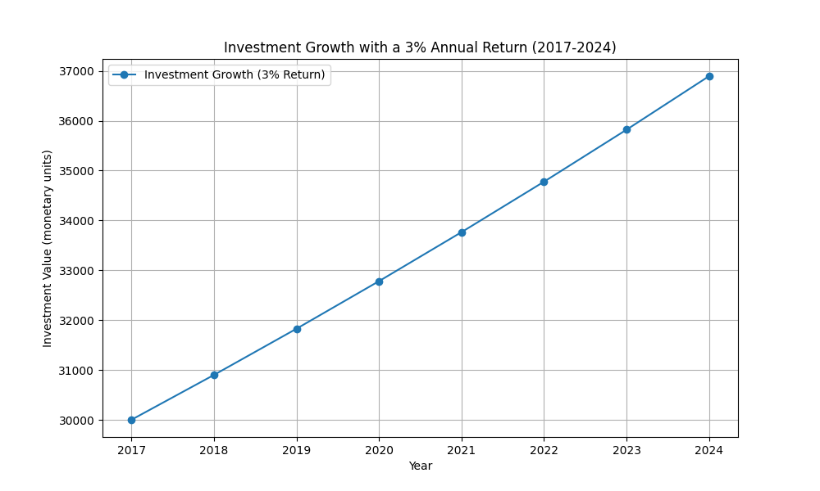
A picture is worth a thousand words

Slide 11
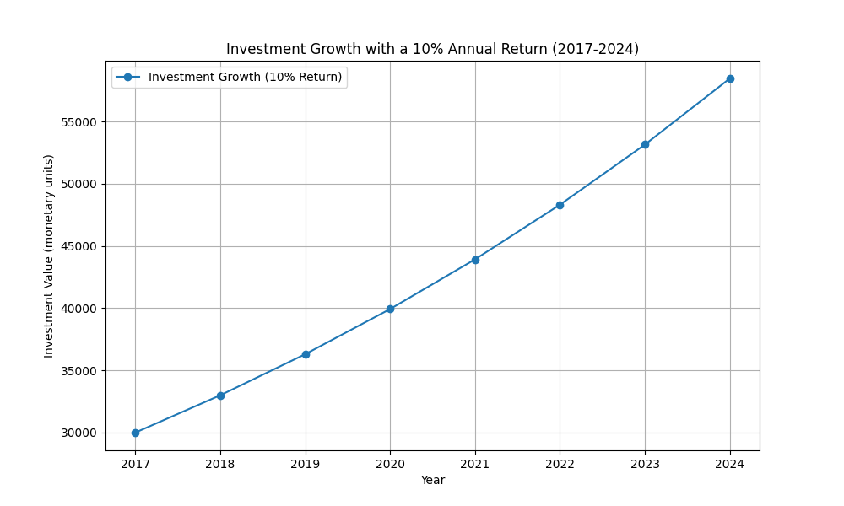
A picture is worth a thousand words

Slide 12

03
Markets: SP500, Bonds & Bitcoin

Slide 13

The markets
Bonds USA (or any other country)
SP500
Bitcoin
Bonds are debt securities issued by governments or corporations to raise capital. When you buy a bond, you're lending money in exchange for periodic interest payments and the return of the principal at maturity.
The S&P 500 is an index of 500 of the largest publicly traded companies in the U.S. It’s often used as a benchmark for the overall performance of the U.S. stock market.
Bitcoin is a decentralized digital currency, meaning it’s not controlled by any government or institution. It operates on a peer-to-peer network, and transactions are recorded on a public ledger called the blockchain.

Slide 14

Long Term fight vs inflation
High profit
Bitcoin
Profit
SP500
Break-even point
Bonds
Loss
Not doing nothing
Big loss
Making mistakes by letting yourself be guided by feelings

Slide 15


Analysis of the markets

Slide 16

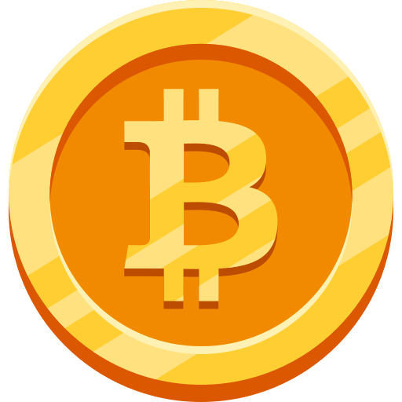
251,923

Slide 17

Rentability vs Volatility
04
Bitcoin => 22.8% SP500 => 10.26% Bonds => 3.08%

Slide 18
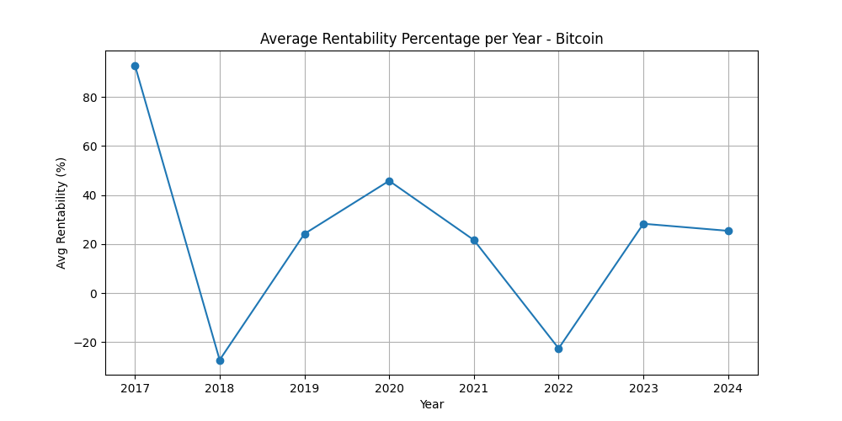
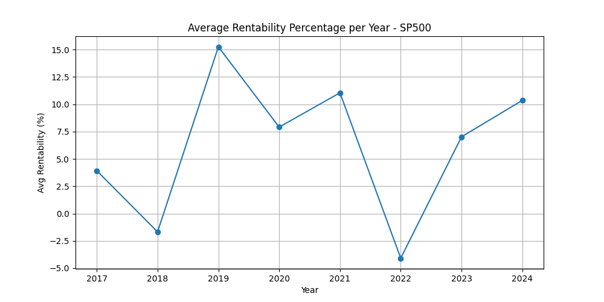
Rentability Btc vs SP500
Bitcoin has historically shown higher long-term returns compared to the S&P 500. While the S&P 500 has provided steady annual growth of around 8-10%, Bitcoin's annualized returns have been significantly higher, despite its volatility. However, both Bitcoin and the S&P 500 experience good and bad years, with periods of high returns and occasional downturns.
The key to successful investing lies in taking a long-term perspective, as short-term fluctuations can be extreme, but the overall trend favors growth over time. Bitcoin remains a high-risk, high-reward investment, whereas the S&P 500 offers more stability but lower yields.

Slide 19
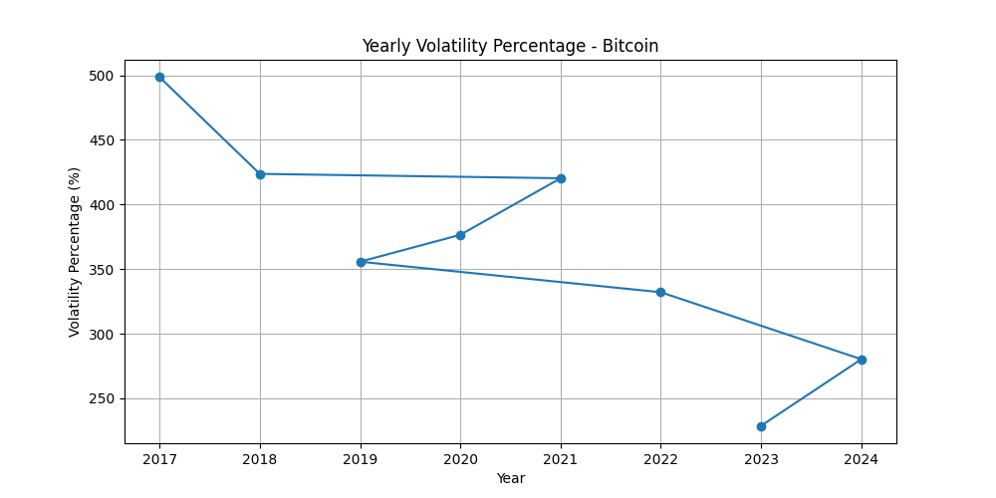
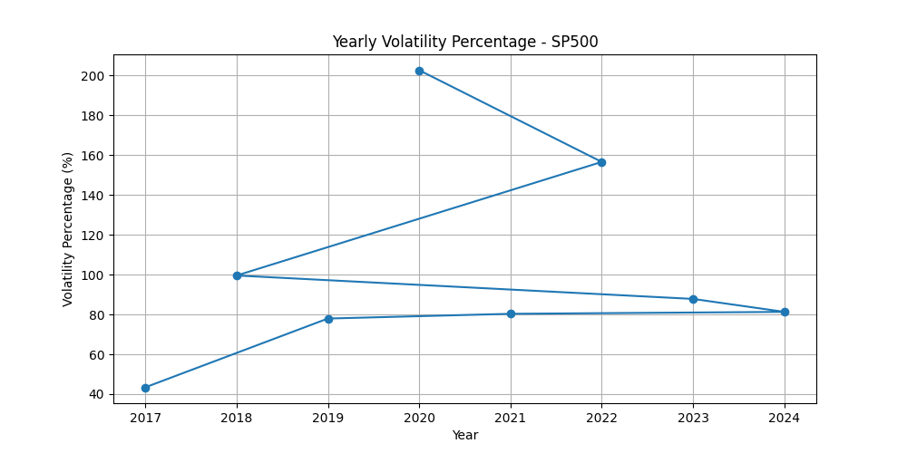
Volatility
As shown in the graphs, volatility is represented from highest to lowest, creating a vertical visualization. This highlights how some years are more volatile than others in both markets. While Bitcoin is clearly more volatile than the S&P 500, both experience fluctuations in volatility over time. Certain periods see increased market instability, while others remain relatively stable. This demonstrates that volatility is not constant but varies depending on economic conditions, investor sentiment, and market cycles.

Slide 20

05
Investment profile: Which one is yours?

Slide 21
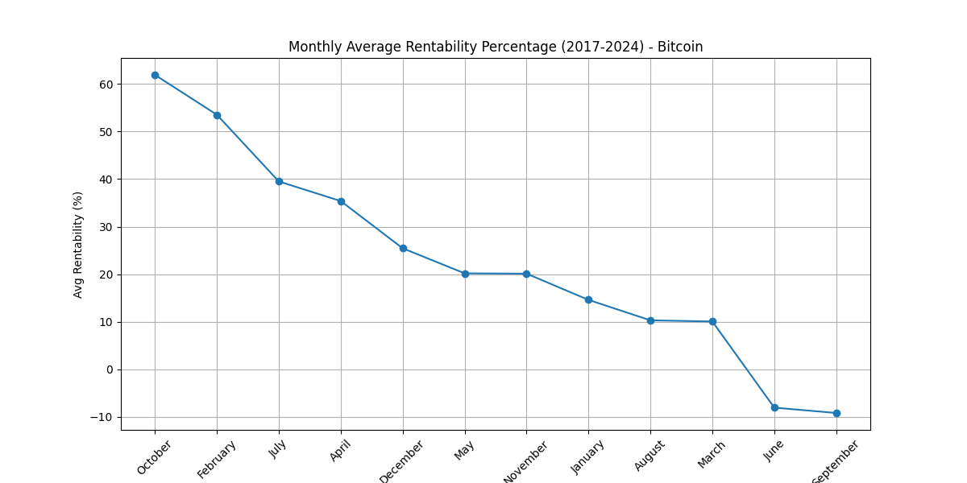
Bitcoin: The High-Risk, High-Reward Investor
Bitcoin attracts investors willing to take on higher risk in exchange for potentially greater long-term rewards. Due to its volatility, Bitcoin requires a strong mindset and a long-term perspective. However, active investors can refine their market skills to navigate Bitcoin’s cyclical nature, buying during deep market downturns and selling in peak bullish years—such as the year following a Bitcoin halving. While Bitcoin offers the highest upside, it also demands resilience and the ability to endure sharp price swings, making it suitable for those who embrace risk and market timing as part of their investment strategy.

Slide 22
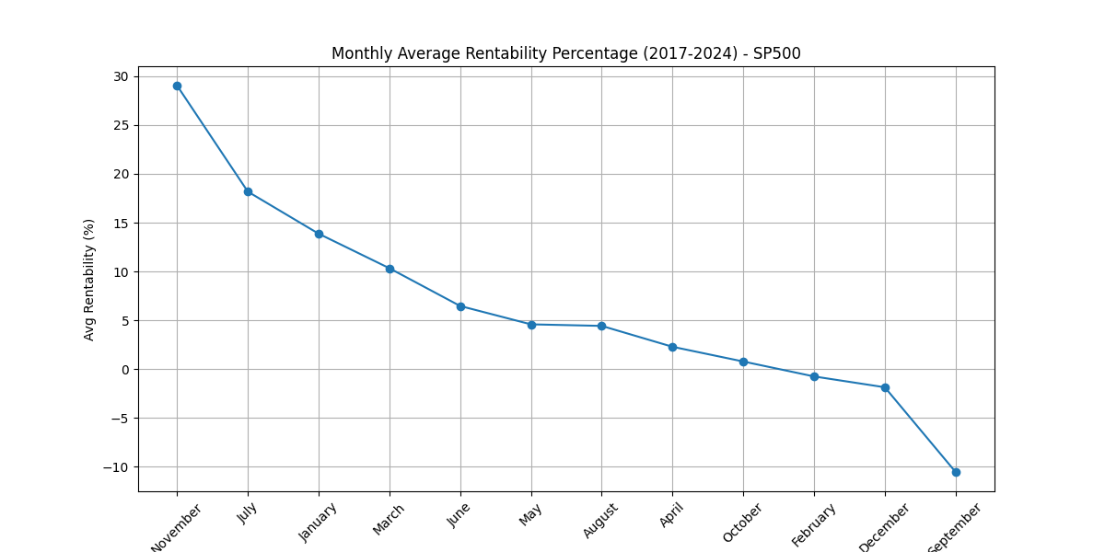
S&P 500: The Balanced Investor
The S&P 500 provides a more stable investment path, appealing to those who want long-term growth with moderate risk. While it doesn’t match Bitcoin’s extreme returns, it also avoids its extreme volatility. Investors can still optimize their strategy by considering market trends, seasonality, and economic cycles. Though less skill is required for short-term decision-making compared to Bitcoin, timing the market can still enhance returns.

Slide 23
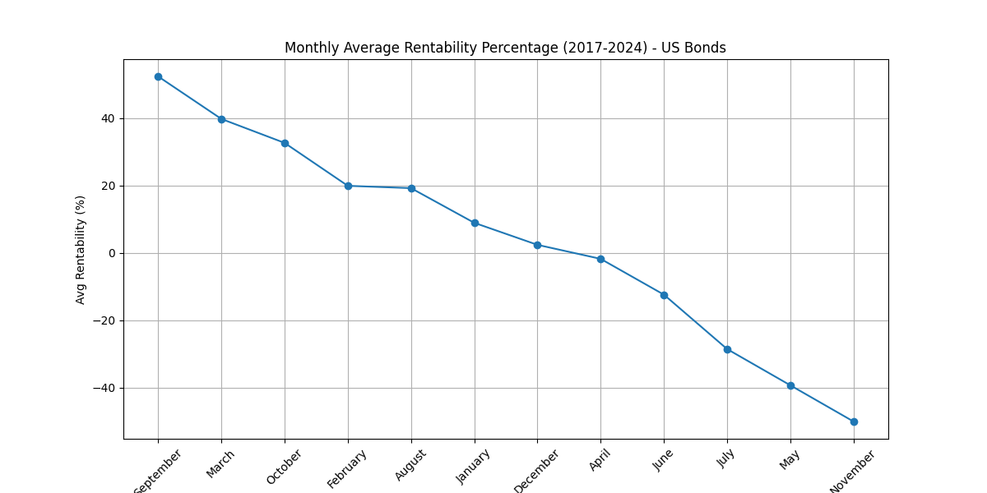
Government Bonds: The Conservative Investor
Government bonds are the least volatile option, ideal for those prioritizing security over high returns. While their growth potential is lower than Bitcoin or the S&P 500, they offer predictable income and stability, making them a defensive choice against inflation. A comparable alternative is high-yield savings accounts or neobank accounts offering around 3% annual returns—providing a low-risk way to preserve purchasing power. Although bonds may not generate life-changing wealth, they serve as a crucial hedge, ensuring steady returns with minimal market stress, perfect for those who prefer a hands-off approach to investing.

Slide 24

06
Financial plan

Slide 25
With compound interest, even passive investors can achieve significant long-term returns by consistently investing. While stability is preferred, assets like Bitcoin can still be included, as they offer the highest long-term profitability despite their volatility.
The best approach is diversification—allocating more to lower-risk assets and smaller portions to volatile ones. A balanced portfolio of bonds, the S&P 500, savings accounts, real estate, and Bitcoin ensures growth while managing risk. Regardless of strategy, investing is essential to combat inflation.
For those eager to learn, investing can be more active, leveraging market cycles to optimize returns. However, this requires discipline and a strong mindset, as emotional decisions can lead to losses. Whether passive or active, the key is risk management, patience, and a long-term perspective.

Slide 26

The best Wallet for Risk Profile
10-15%
30-45%
Bitcoin
Bonds & Savings Accounts 3% Rentability
(High growth potential but high volatility)
(Security and stability)
30-40%
15-25%
SP500
Real Estate
(Steady long-term growth)
(Tangible asset, inflation hedge)

Slide 27
The best Wallet for low Risk Profile
5-10%
40-55%
Bitcoin
Bonds & Savings Accounts 3% Rentability
(High growth potential but high volatility)
(Security and stability)
25-30%
15-25%
SP500
Real Estate
(Steady long-term growth)
(Tangible asset, inflation hedge)

Slide 28
—Warren Buffett
"The stock market is designed to transfer money from the Active to the Patient."

Slide 29
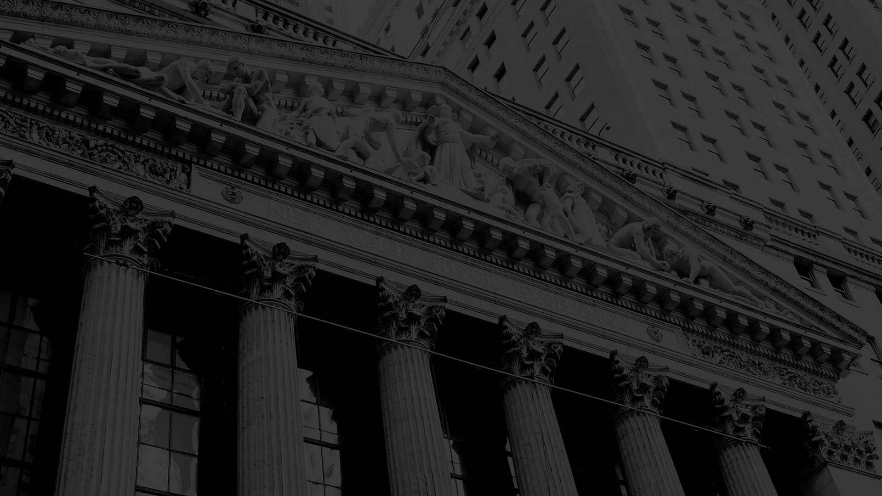
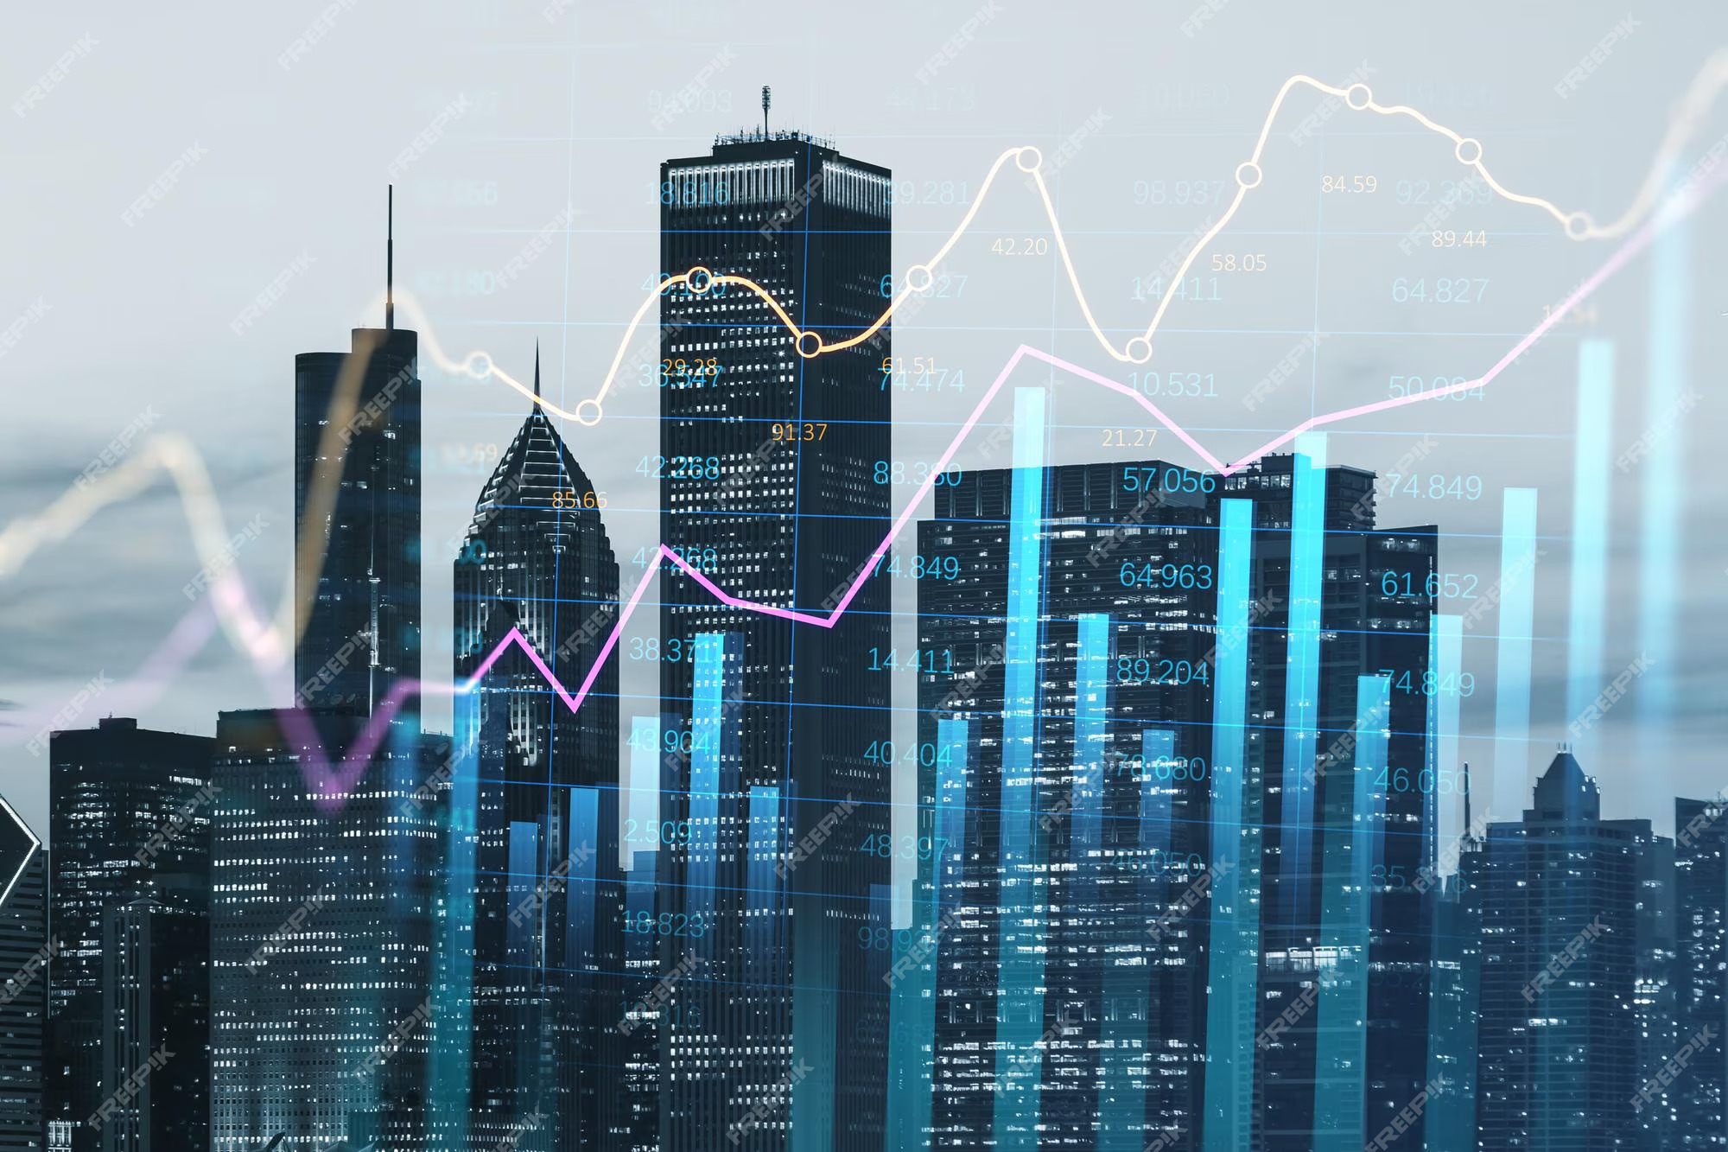
Thanks
Do you have any questions?
By Carlos Urrutia Martínez
Please keep this slide for attribution

